Slide 1
Convolutional Neural Networks (II)

Slide 2
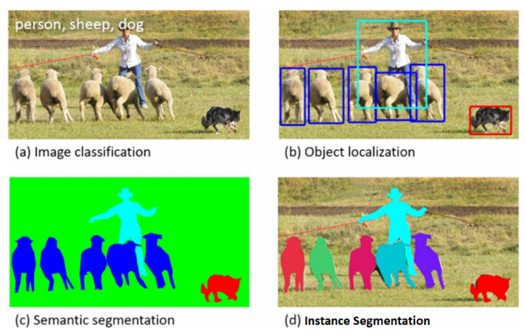
Image Segmentation
Partitioning an image into multiple image segments, also known as image regions or image objects (sets of pixels).
Locate objects and boundaries
Assigning a label to every pixel in an image such that pixels with the same label share certain characteristics.

Slide 3
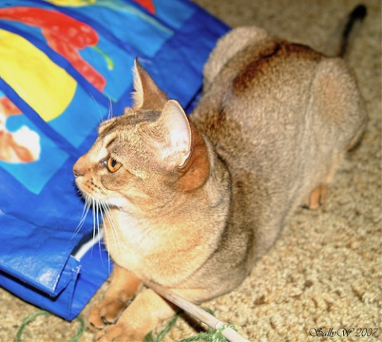
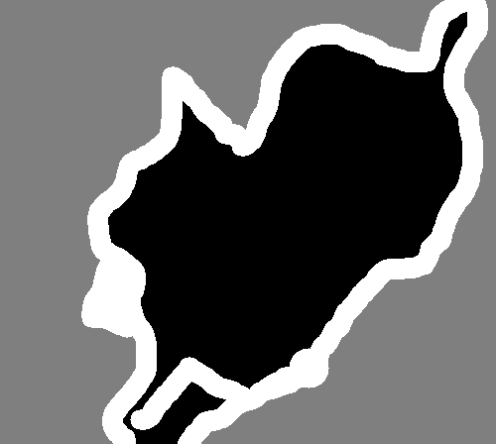
The Oxford-IIIT Pet Dataset
  http://www.robots.ox.ac.uk/~vgg/data/pets
  Cats and Dogs
  Pixel level segmentation (Trimap)
    1: Foreground
    2:Background
    3: Not classified
Original image
Labeling (mask)

Slide 4
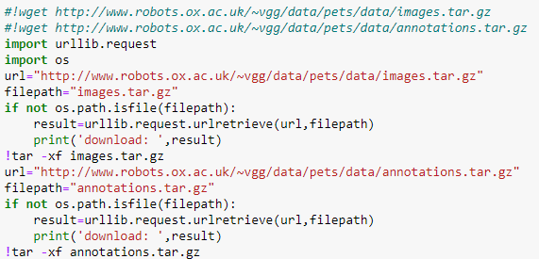
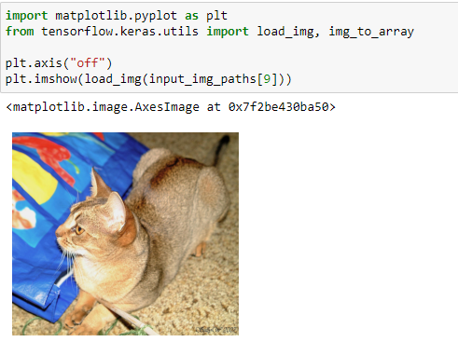
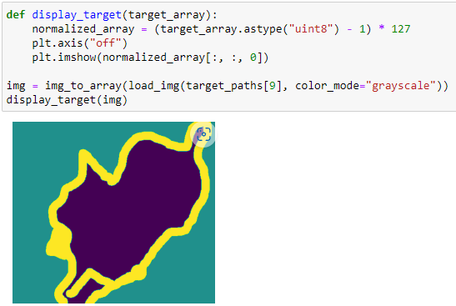
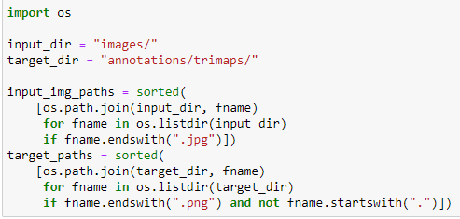
Download data
decompression
Show mask
1,2,3 → 0,1,2 → 0,127,254
Make list of path of files

Slide 5
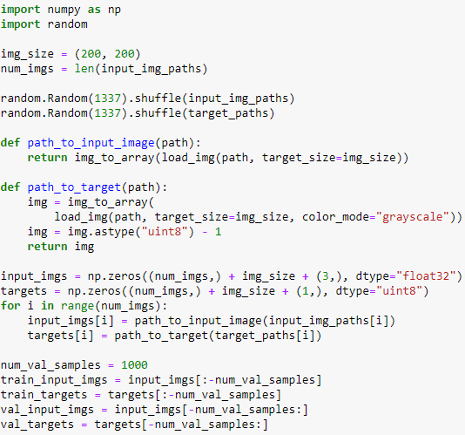
Load image, then transform to an array
1,2,3 → 0,1,2
Create an array of shape (num_imgs, 200, 200,3)
Create an array of shape (num_imgs, 200, 200,1)
Load images and masks into arrays
Split training and validation images

Slide 6
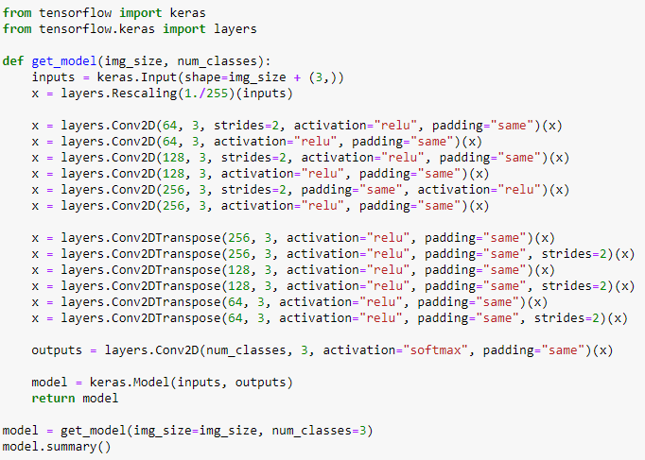
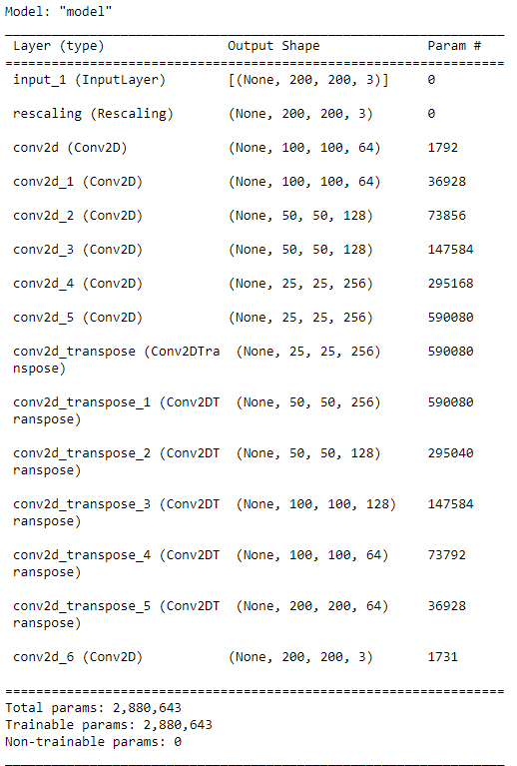
Conv2DTranspose: Transposed convolution layer (sometimes called Deconvolution).
  upsampling

Slide 7
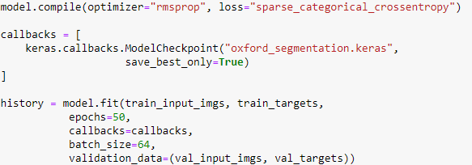
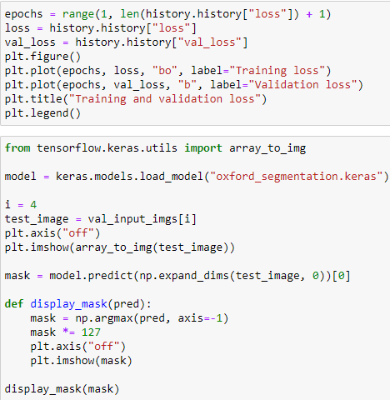

Slide 8
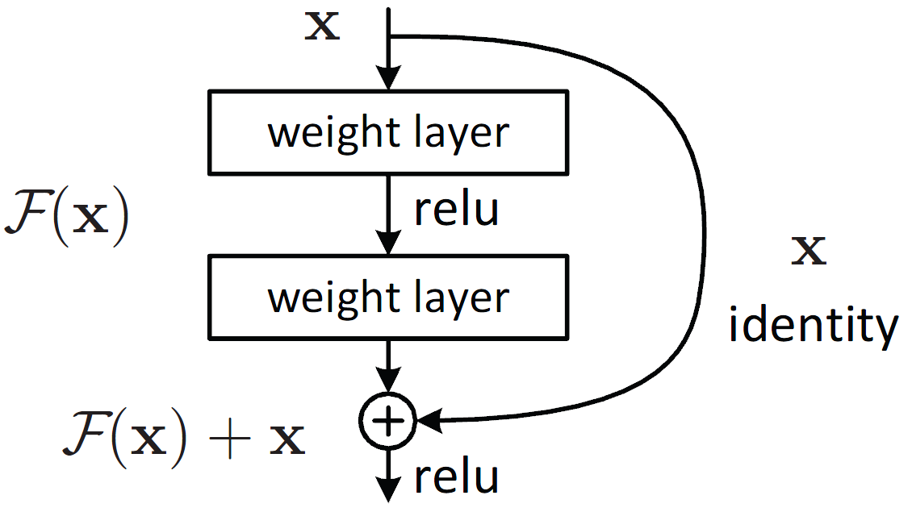
Residual Connection
a type of skip-connection that learn residual functions with reference to the layer inputs, instead of learning unreferenced functions.
Formally, denoting the desired underlying mapping as H(x), we let the stacked nonlinear layers fit another mapping of F(x):=H(x)−x. The original mapping is recast into F(x)+x.

Slide 9
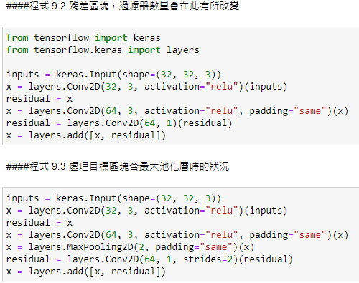
Residual has only 32 channels, but the output of the second Conv2D has 64 channels. Use 64 1x1 filters (no activation) to change the shape of residual to 64 channels.
Has maxpooling after the second Conv2D
Use strides=2 to downsampling residual.

Slide 10
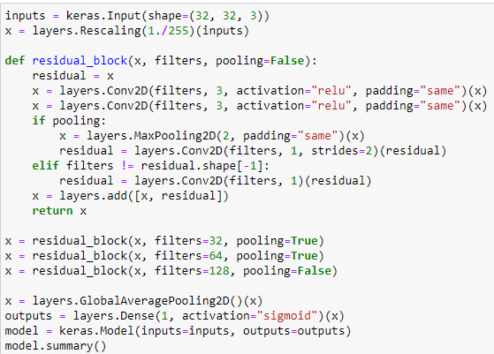
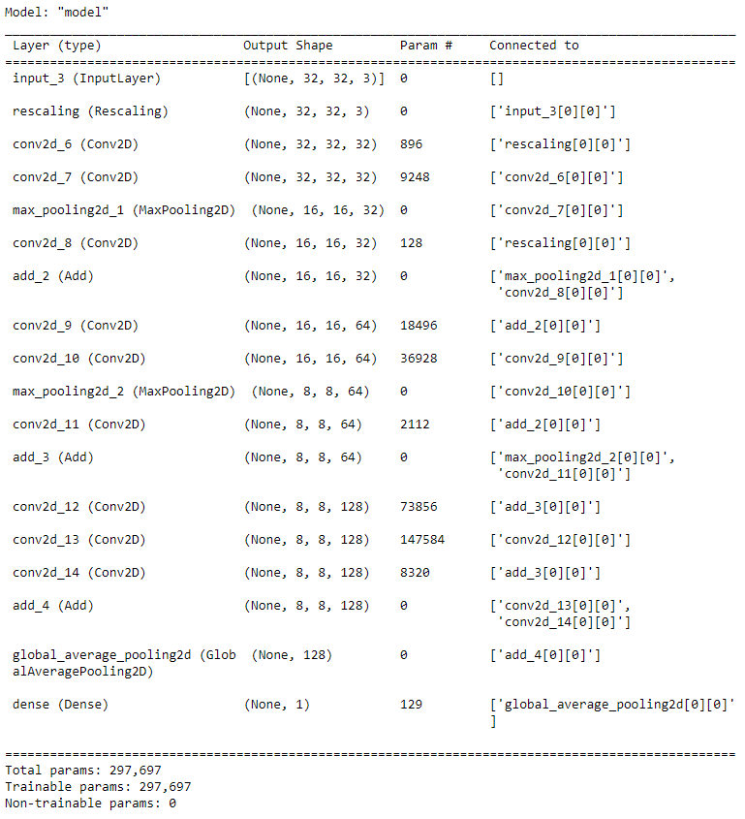

Slide 11
Batch Normalization
Batch normalization applies a transformation that maintains the mean output (of the current batch of inputs) close to 0 and the output standard deviation close to 1.
https://medium.com/ching-i/batch-normalization-%E4%BB%8B%E7%B4%B9-135a24928f12

